Slide 1
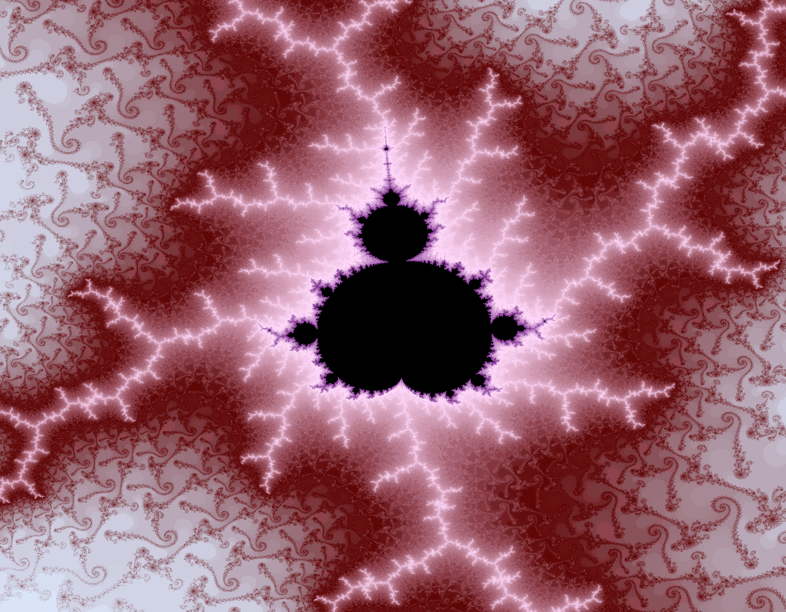
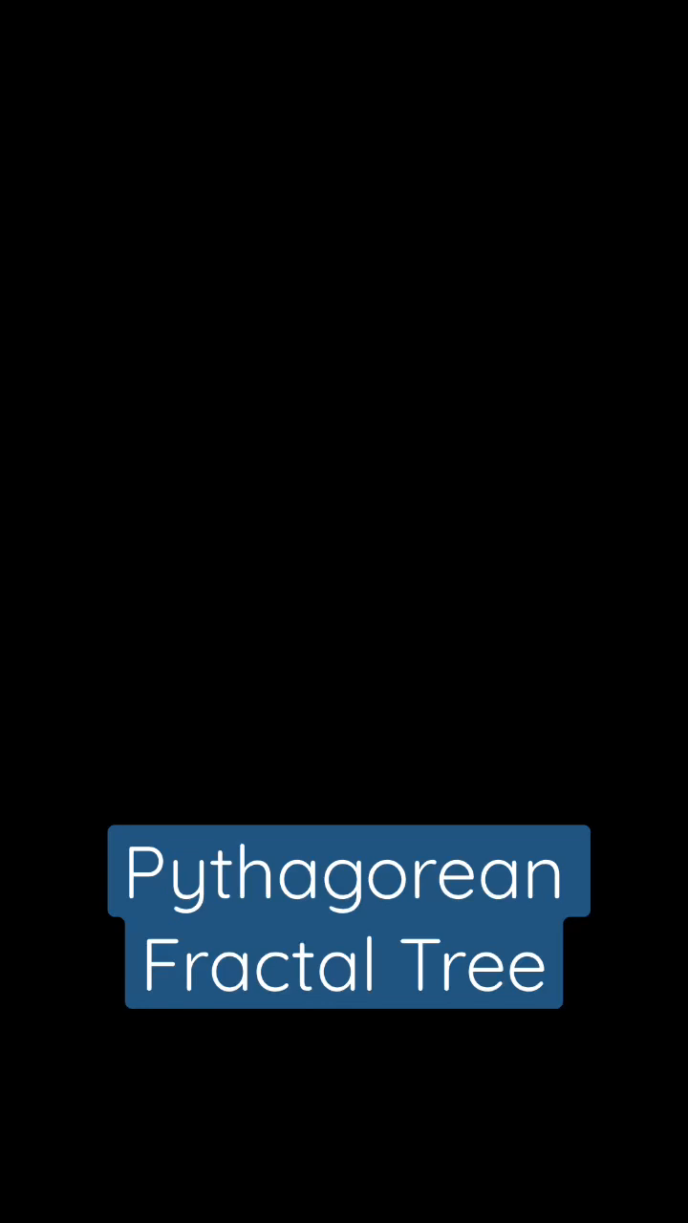

Slide 2
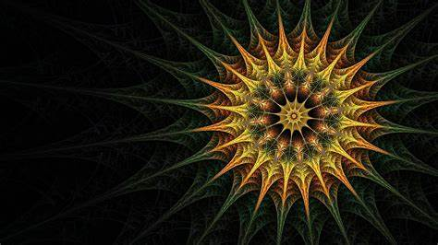

ABSTRACT
Fractals are a recurring, never-ending pattern that continues to form an infinitely complex, self-similar all across at different scales. These are images or graphs and designs that look fascinating and elegant to look at and observe.

Slide 3
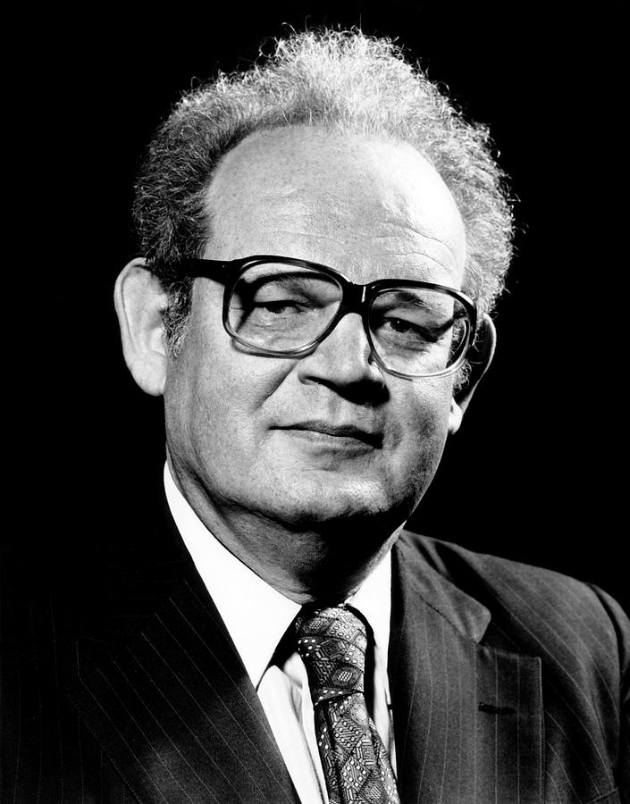
“A fractal is a way of seeing infinity.”
-Benoit Mandelbrot
Benoit Mandelbrot is known as the "father of fractal geometry. He coined the term "fractal" in 1975 to describe irregular shapes in nature and in mathematics that exhibit self-similarity. He referred to himself as a "fractalist" and is recognized for his contribution to the field of fractal geometry, which included coining the word "fractal", as well as developing a theory of "roughness and self-similarity" in nature.

Slide 4
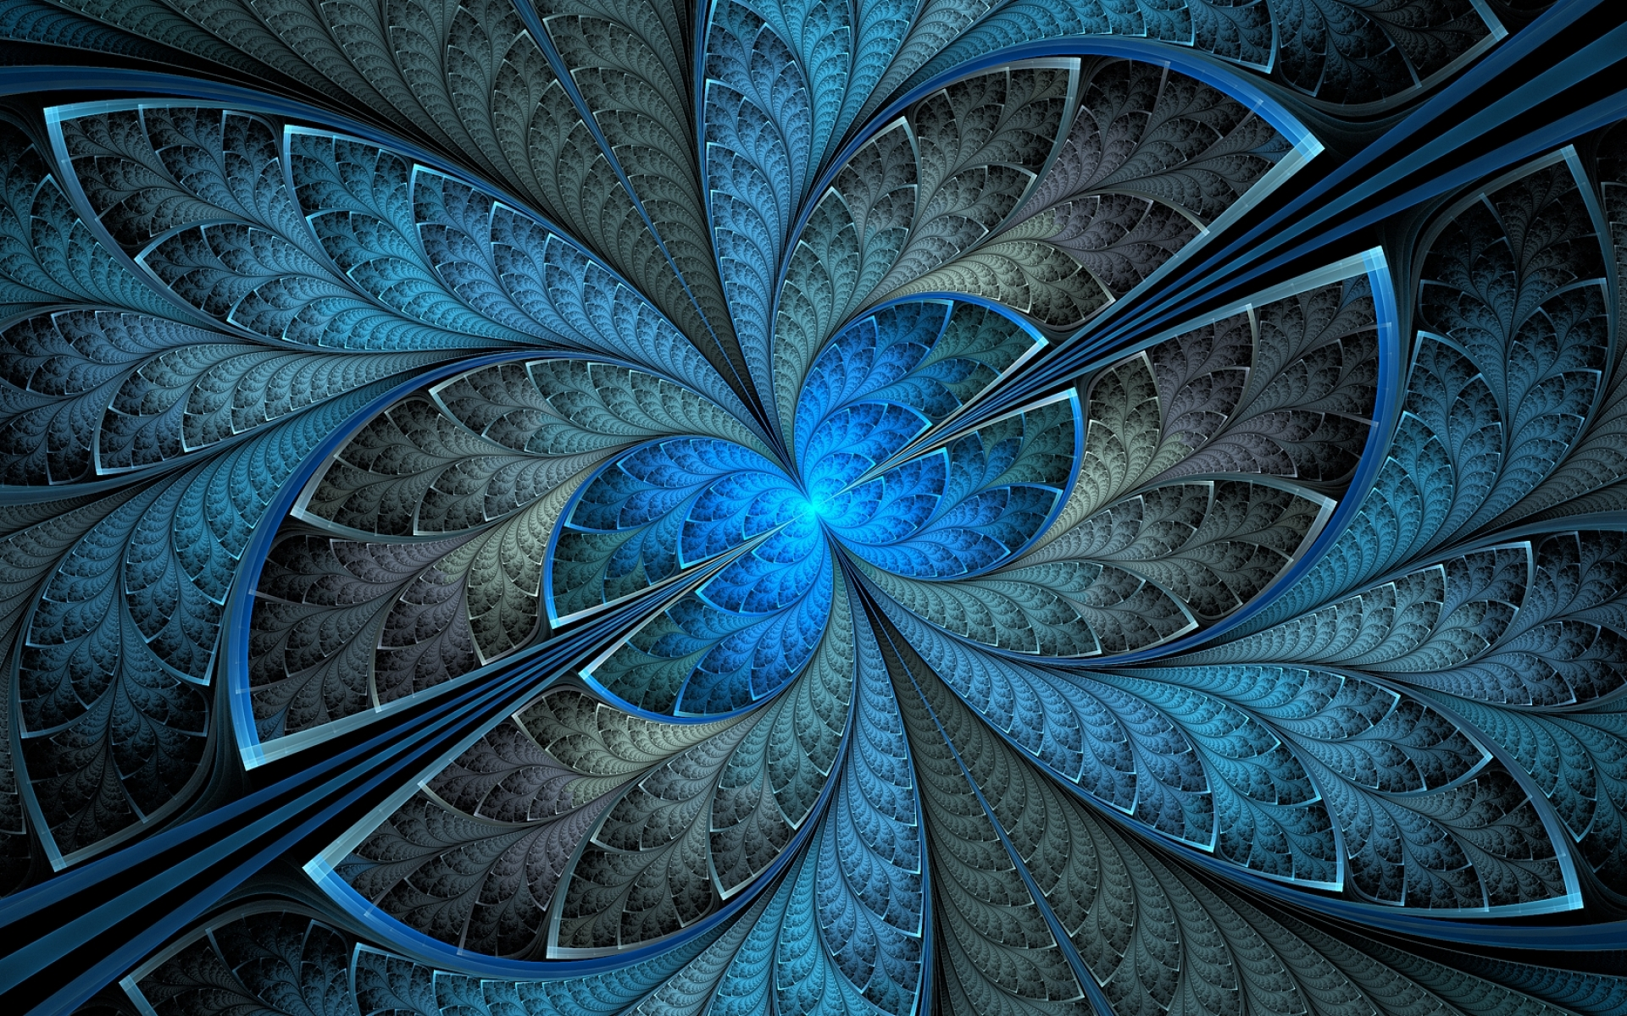
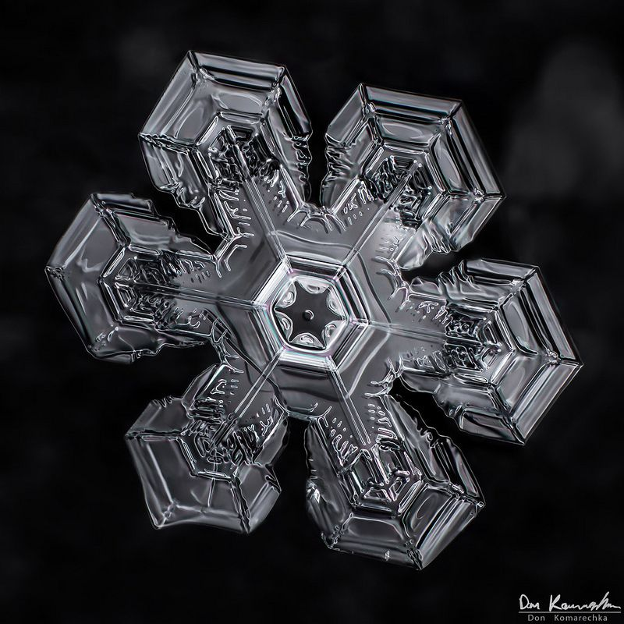
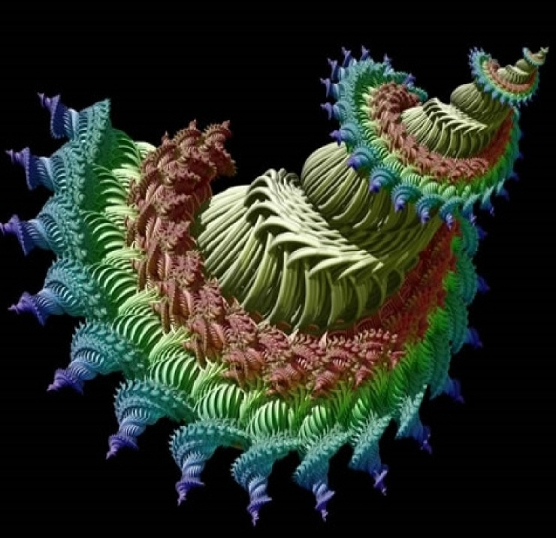
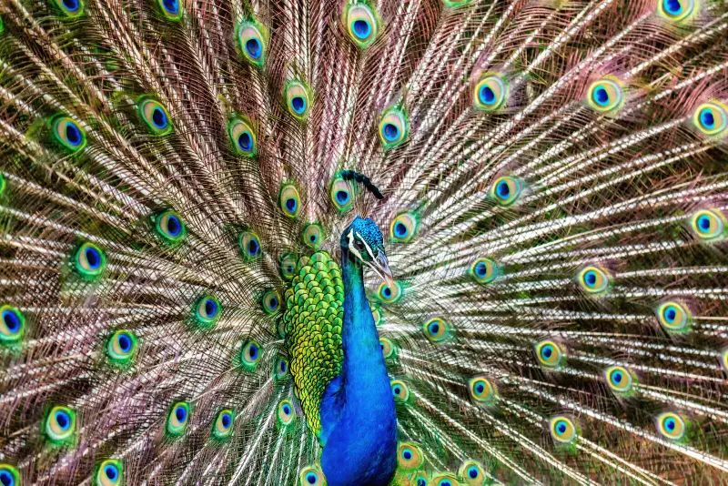
INTRODUCTION
Fractals, repeating patterns with self-similarity at various scales, are found in nature and pure mathematics. The study of fractals has significantly impacted diverse scientific fields, including computing, telecommunications, biology, and medicine. Fractals represent patterns of change, and despite being associated with chaos, they can also be viewed as structured manifestations of constant change in the universe.

Slide 5

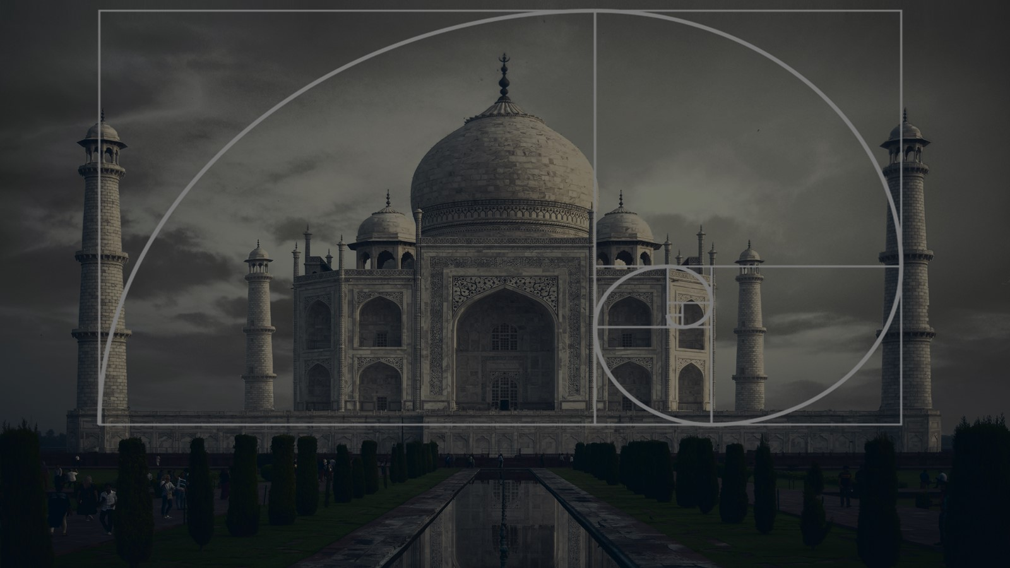
EXISTING LITERATURE
The literature on fractals showcases their multidisciplinary relevance, offering a versatile framework to understand and model complex systems. The exploration of fractals spans a wide range of fields, including science, art,
and technology, with ongoing research pushing the boundaries of their applications and implications.

Slide 6
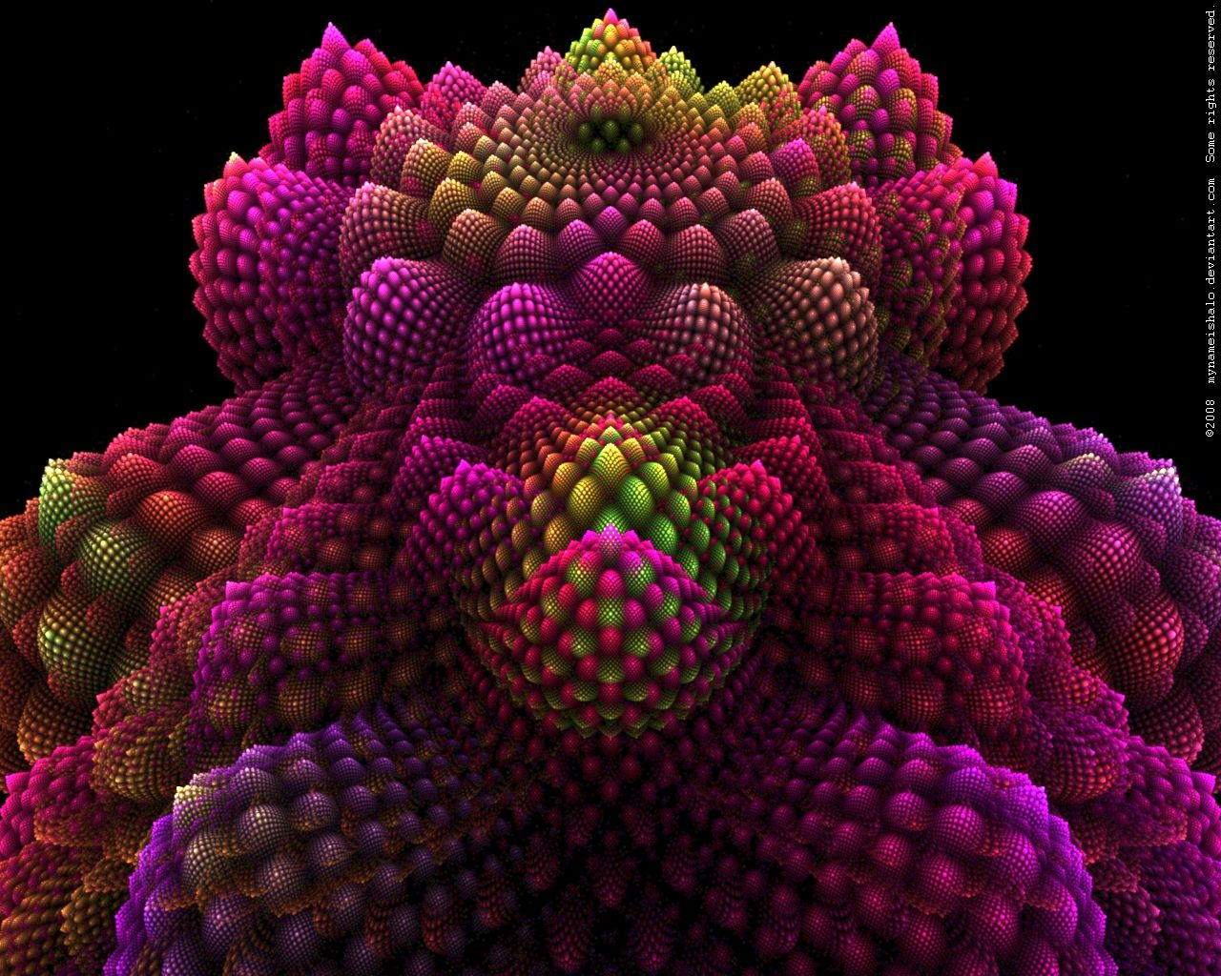
Julia Sets
Mathematical sets that are associated with complex numbers and iterative processes. They are named after the French mathematician Gaston Julia, who studied them in the early 20th century.
Mandelbrot Set
Specific set of complex numbers defined by iterating a simple mathematical function. It is named after the mathematician Benoît B. Mandelbrot, who introduced the set in 1980.
Fractional Dimensional Sets
Mathematical sets that exhibit a dimension that is not a whole number. Unlike traditional geometric objects with integer dimensions they have dimensions expressed as fractions or decimals.

Slide 7
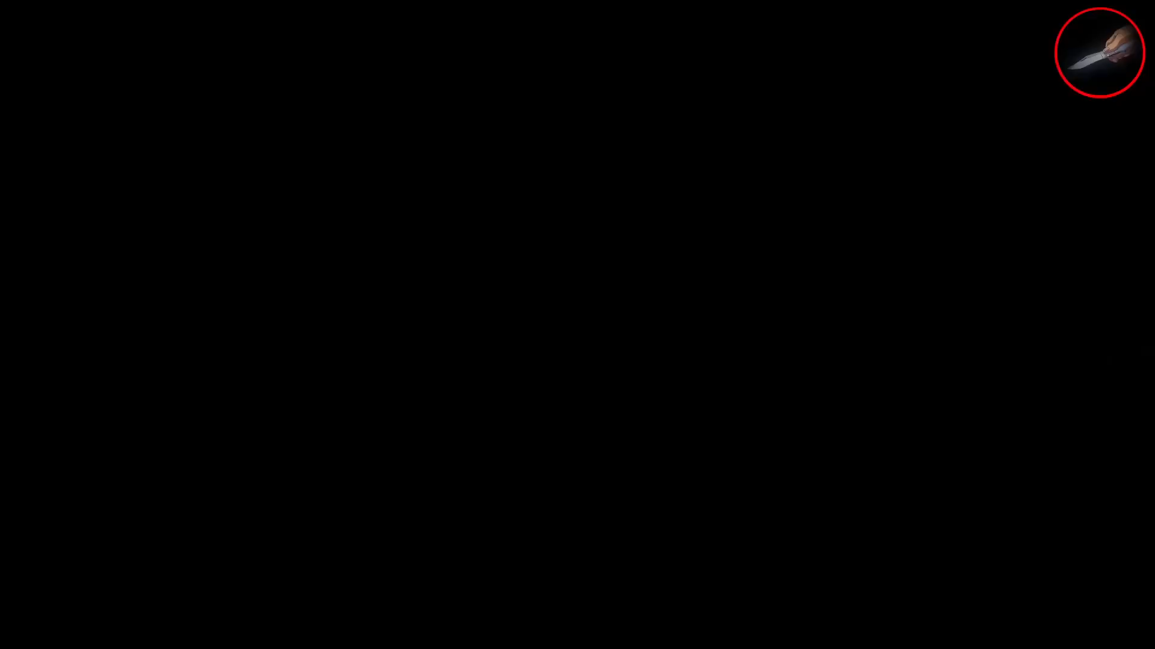
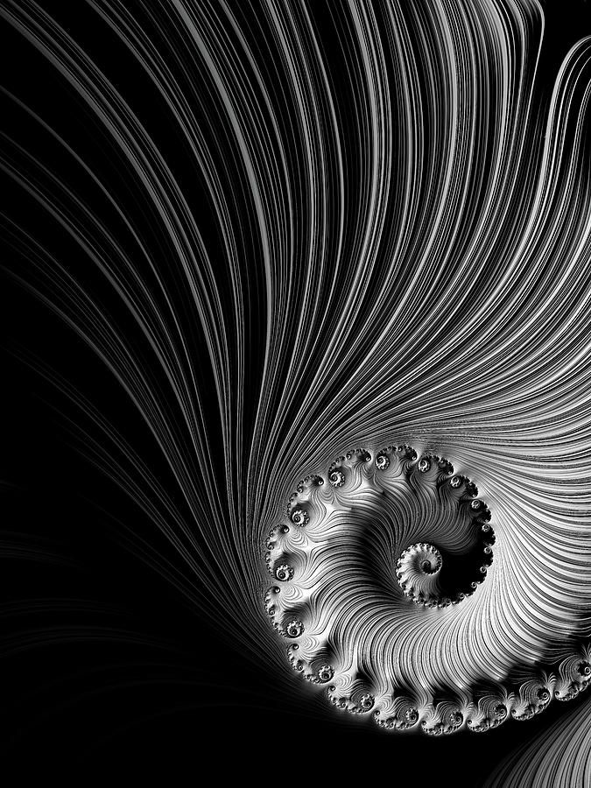
ORIGIN
Karl Weierstrass(1870)
Presented the first example of a function that is continuous everywhere but differentiable nowhere.
Helge von Koch(Early 20th Century)
Introduced the famous Koch snowflake curve.
Benoit Mandelbrot(1975)
“Fractal" gained prominence when Benoit Mandelbrot,
in his seminal work "The Fractal Geometry of Nature"

Slide 8
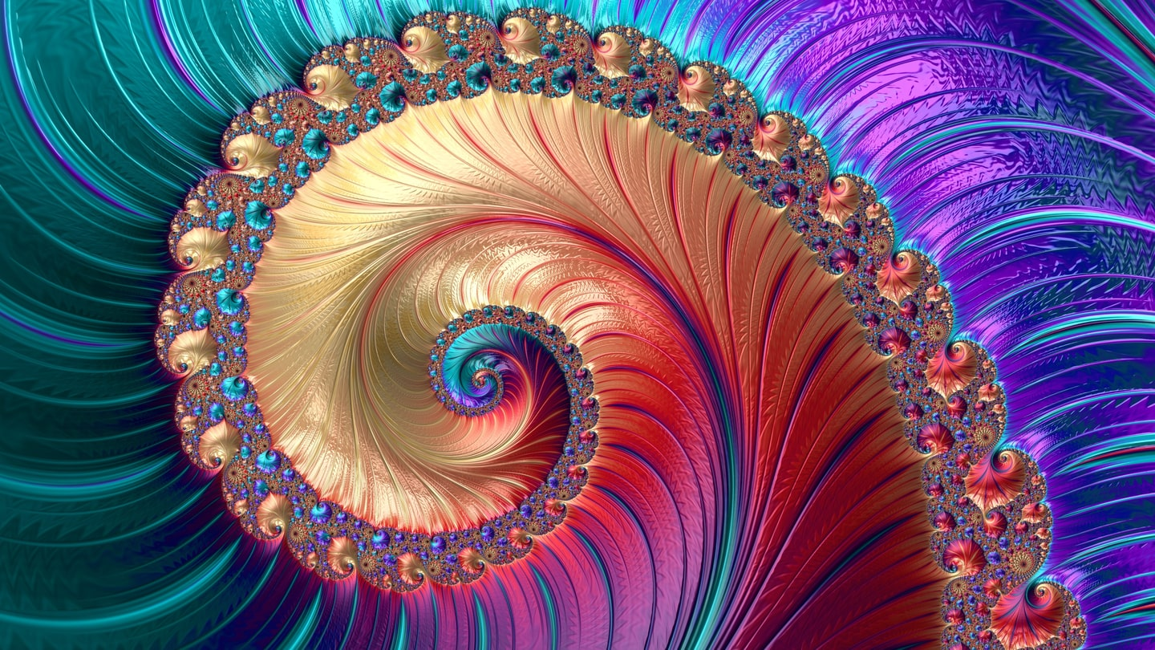

Slide 9
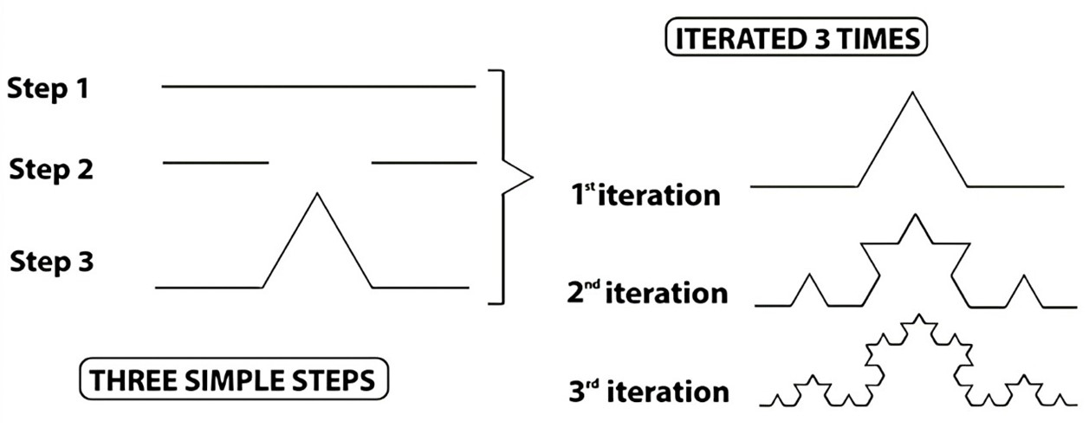
ITERATIONS
Iteration is fundamental to dynamics, chaos, analysis, recursive functions, and number theory. In most cases the kind of iteration required in these subjects is integer iteration, i.e. where the iteration parameter is an integer. However, in the study of dynamical systems continuous iteration is paramount to the solution of some systems.

Slide 10
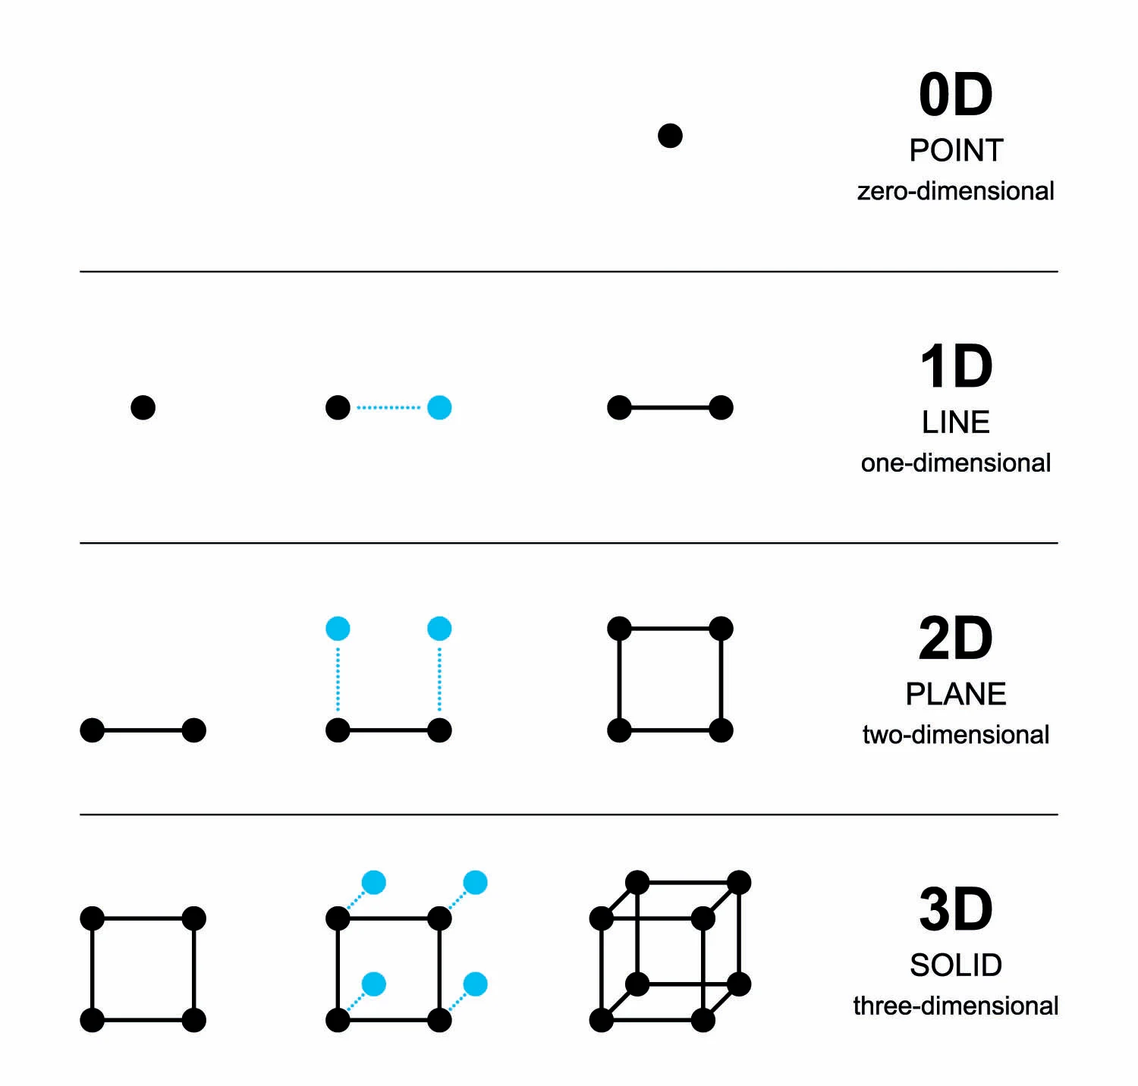

FRACTAL DIMENSION
Fractional dimensionality captures self-replicating structures within fractals, showcasing their complexity and the richness of detail at various scales. For calculation we get the formula:
D = $\frac{\log{n}}{\log{m}}$
where n -> no. of self-similar pieces at each iteration
m ->magnification factor by which the pieces are reduced at each iteration

Slide 11
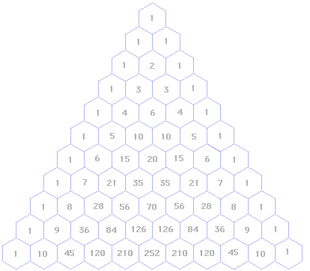

PASCAL’S TRIANGLE
Pascal's Triangle is a mathematical arrangement of numbers named after the French mathematician Blaise Pascal, although it was known to Chinese mathematicians over 500 years earlier. Used in various mathematical concepts further. The formula for forming the triangle is:
$C\left(n,k\right)=$ $\frac{n!}{k!\left(n−k\right)!}$
where n->row no.
k->position within row

Slide 12
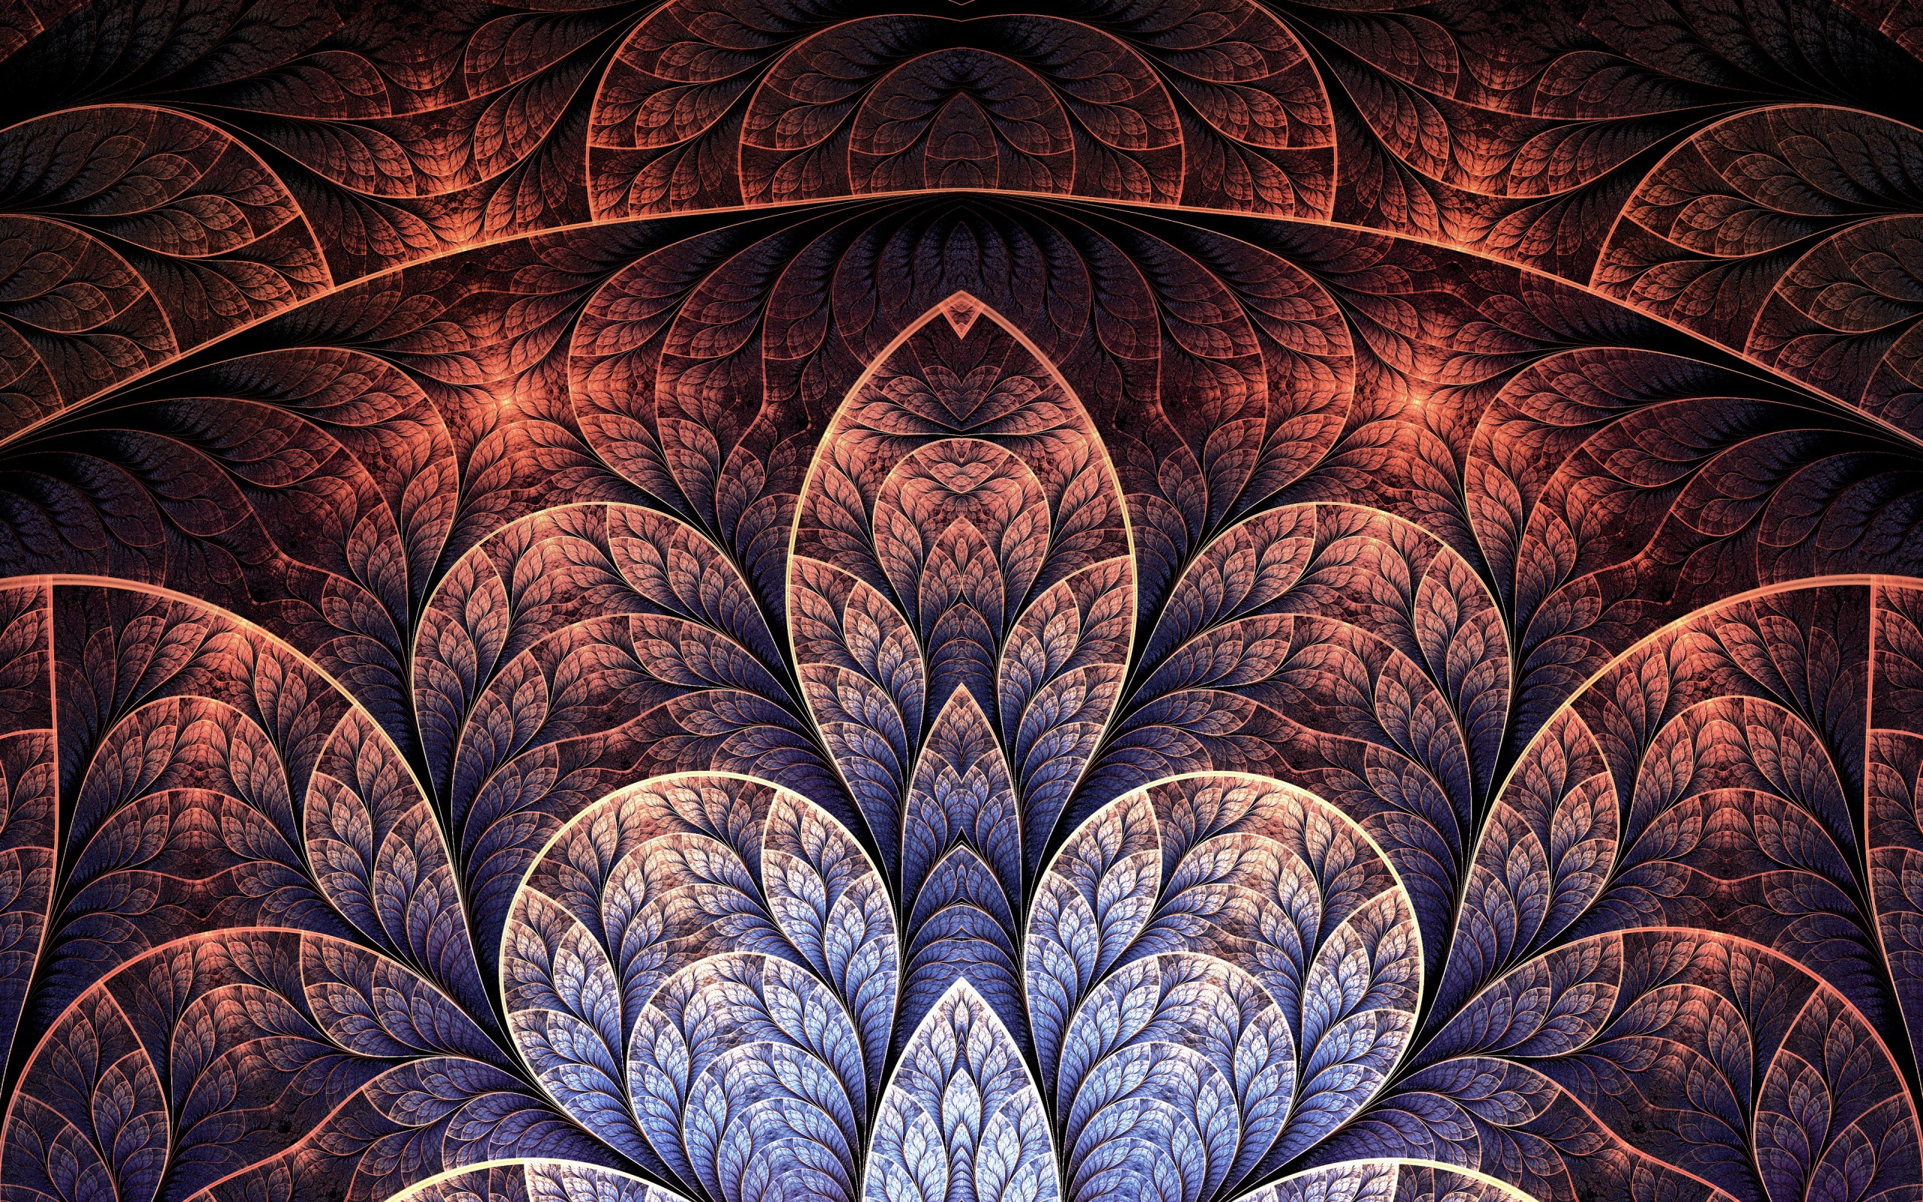

Slide 13
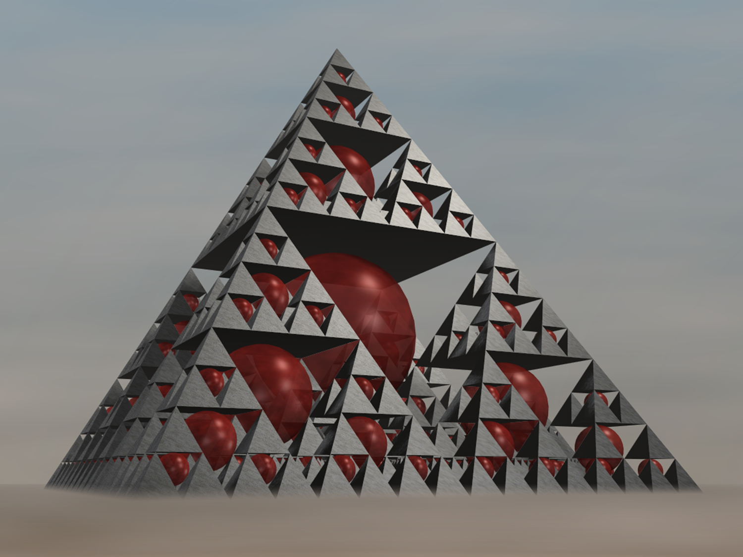
Mathematics
Study the properties and equations governing concepts of geometry.
Physics
Study of chaotic systems and turbulence. Along with framework for modeling and understanding complex natural phenomena.
Virtual Reality
Their self-replicating patterns and complex geometry enable the development of dynamic and visually engaging VR content.

Slide 14
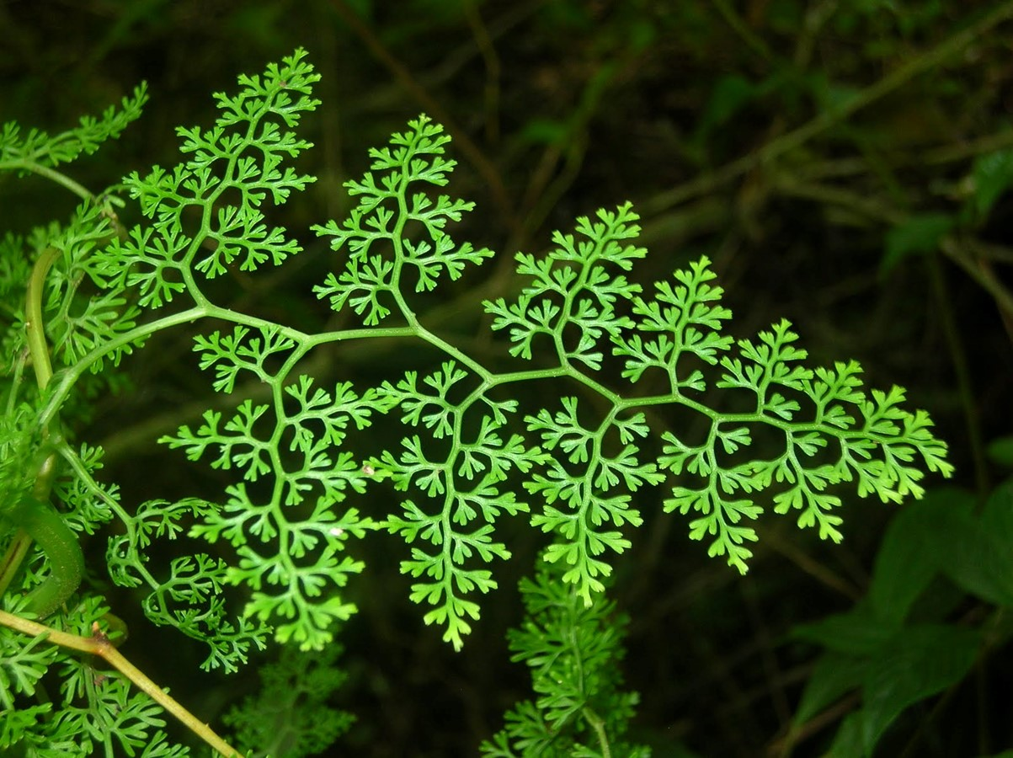
Biology
Helps in describing the branching patterns of blood vessels, the complexity of neural networks, and other intricate biological forms.
Medicine
Used in in medicine to study physiological processes.
Environmental Science:
Utilized to model and understand natural landscapes and environmental processes.

Slide 15

Economics and Finance
Provides a unique perspective on the dynamics of financial markets, helping researchers and analysts

Slide 16
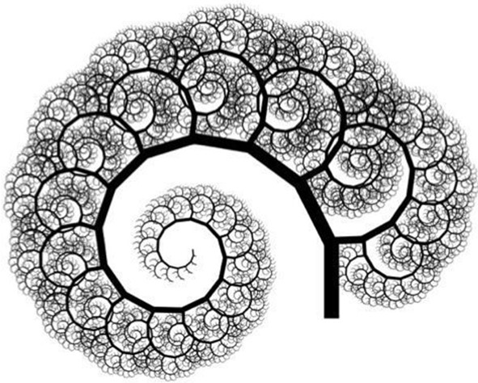
Art
Involves the creation of visually stunning images using mathematical algorithms
Education
Their visual appeal, combined with mathematical concepts, makes them valuable for teaching complex ideas to students at various educational levels, fostering an appreciation for the beauty of mathematics.
Communication and Information Theory
Study of chaotic systems and turbulence. Along with framework for modeling and understanding complex natural phenomena.

Slide 17
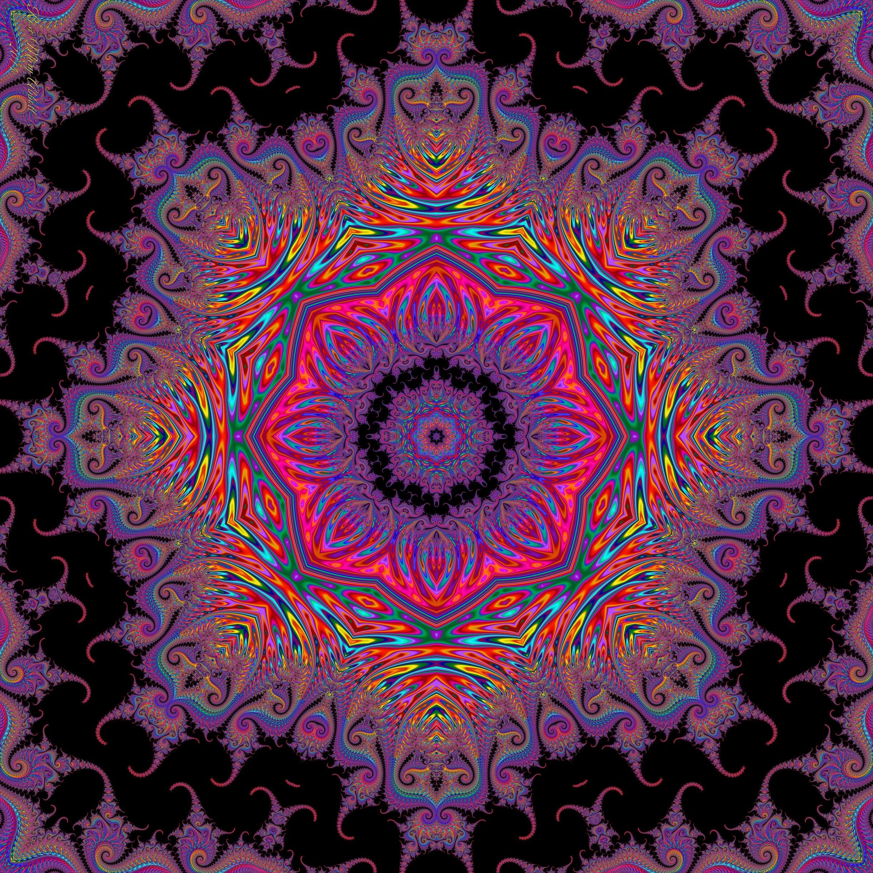
CONCLUSION
In conclusion, exploring fractals has been like unraveling a captivating story of shapes that repeat themselves endlessly in both art and nature. In essence, the study of fractals not only captures our eyes with mesmerizing visuals but also uncovers profound mathematical principles that weave through the rich tapestry of exploration in mathematics

Slide 18
THANK YOU
Nutan Kumari(2022341)
Rohit Singal(2022417)
Priyanshu Yadav(2022383)

